Slide 1



















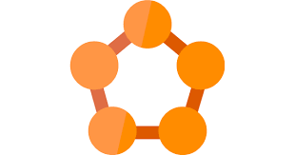

Enterprise Data Hub – Azure Synapse - Reference Architecture
Internal Sources
Acquire
Compute
Data Access
Visualize & Publish
Pull
ADF
Engineer
Analyze
Master data
Published
MF File Pull
ADF
Azure ML
2017
Azure ML
Synapse Analytics
Azure Analysis Services
Mainframe(MF)Files
Synapse Analytics
PowerBI
Landing
Batch
Polybase
Exploratory Analytics
Descriptive Analytics
Push
ERP (PPM, HR, Fin)
Metadata + Access Control + Governance
REST API
Blob Store
Manage
External Metastore
Azure Data Catalog
Enterprise Content Management
Curated
Published
Publish
Streaming Data
Raw
ADF
Persist
Operational
System(s))
Azure Event Hub
ADLS Gen2
ADLS Gen2
Synapse Managed Storage
Web App Services
CDC and Streaming
Storage
Archived
Other Sources
CDC
Push
Streaming Analytics
Blob Store
MIMIX Share
Azure Service Fabric
External Sources
Analyze
LEGEND:
- Non-Microsoft new tools
- Non-Microsoft existing tools

Slide 2

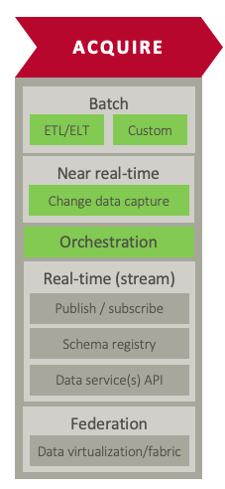
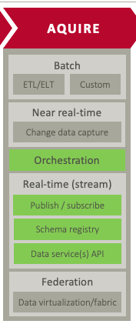









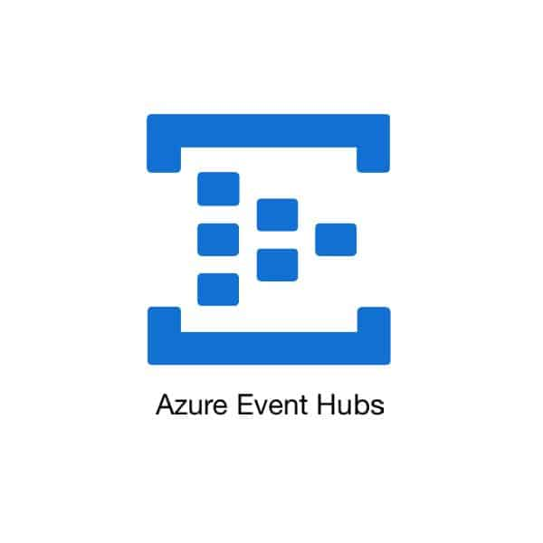
Ingestion – Reference Architecture
Metadata Driven ingestion is the industry standard methodology. Ingestion engine can be implemented via different technologies and tool sets
Batch
Streams
Ingestion Reference Architecture
Sources
Ingestion Framework
Targets
Batch
Metadata Configurations
RDBMS
Raw
Mainframe Files
Metadata Store
Ingestion
Landing Blob Store
Source & Target Connections
Data Extraction
Flat Files
Column Mapping
ADLS Gen2
Data Mapping
Rules
CDC
Data Delivery
MIMIX Share
Streaming
Ingestion Engine
Azure Data Factory | Syncsort DMX
Ingestion Engine

Slide 3













Kaiser A20 Reference Architecture – Current State
Security
Security
Data Acquisition & Staging
Data Stores
Analytics
Information Access & Delivery
Ingest
Refined
Zone
User
Zone
Data Analytics as a Service
Diagnostic/
Descriptive
Predictive & Prescriptive
Visualization
Portals
In motion
LEGEND
Stream
Reporting
Data Discovery
Power BI
Power BI
Self-service
Messaging
Enriched
Zone
Tenant
Zone
Operational Analytics
Dashboards
Business Intelligence
SQL Server Analysis Services
Advanced Analytics
Raw Zone
Statistical Modelling
Alerts
Real-Time Analytics
Azure ML Server-R
Microsoft Application Native to MS Azure
At rest
Natural Language Processing
Azure Machine Learning
Replicate
LLAP
Archival Zone
Online Analytical Processing
Analytic as a service APIs
RDBMS connect
Express Routes
Azure SQL DB
TEZ
Cognitive
Text
Vision
Spark
Business Rules
Cortana
Azure Data Lake Storage
Ad-Hoc Analysis
Machine Learning
Recommend
Emotion
Third Party Application Native to MS Azure
File-Based
HD Insight Hadoop
Azure ML Studio
Adapters
Bot
Speech
Adapters
Azure Data Lake Storage
HDInsight Hbase
Azure Blob
Additional technologies to enable Analytics
Data Management
Data Management
Metadata
Tagging
Lineage
Data Governance
Data Quality
Master Data Management
Collibra
Waterline Data
Atlas
Collibra
Waterline Data
Tamr
Key Vault
Key Mgmt.
SafeNet
Kerberos
Ranger
Azure Encryption
Authentication
Authorization
Encryption

Slide 4






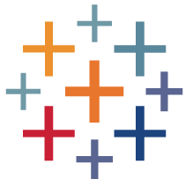

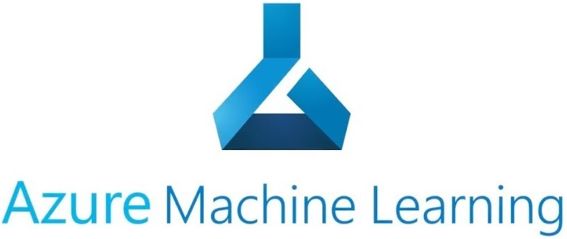


Kaiser A20 Reference Architecture – Future State Options
Security
Security
Data Acquisition & Staging
Data Stores
Analytics
Information Access & Delivery
LEGEND
Ingest
Refined Zone
User Zone
Informatica BDM
Data Analytics as a Service
SNOWFLAKE
Best of Breed on Azure
In motion
Stream
POWER BI
Event Hub
Messaging
AZURE SYNAPSE ANALYTICS
Enriched
Zone
Tenant
Zone
Business Intelligence
Advanced Analytics
Raw Zone
TABLEAU
Microsoft Roadmap Aligned
At rest
Replicate
Archival Zone
Analytic as a service APIs
RDBMS connect
Azure Data Factory
Business Rules
Azure Databricks
Clearlake
SSAS
Microsoft Application Native to MS Azure
File-Based
Kafka
Azure Data Lake Storage
Adapters
Adapters
Express Routes
Third Party Application Native to MS Azure
Data Management
Data Management
AZURE CATALOG & GOVERNANCE(BABYLON)
INFORMATICA DATA MANAGEMENT
Additional technologies to enable Analytics
Metadata
Tagging
Lineage
Data Governance
Data Quality
Master Data Management
Collibra
Waterline Data
Atlas
Collibra
Waterline Data
Tamr
Key Vault
Key Mgmt.
SafeNet
Kerberos
Ranger
Azure Encryption
Authentication
Authorization
Encryption

